Slide 1
Economic Evaluation in Healthcare

Slide 2
ECONOMIC EVALUATION??
Economic evaluation is the process of systematic identification,
measurement and valuation of the inputs and outcomes of two alternative activities, and the subsequent comparative analysis of these.

Slide 3
ECONOMIC EVALUATION OF HEALTHCARE ?
According to WHO it is defined as “that which seeks inter alia-to quantify over times, the resources used in health service delivery, their organization functioning and the efficiency with which the one resources allocated and used for health purposes and the effect of preventive curative and rehabilitative health services on individual and national productivity”.

Slide 4
Drummond et al (1987) defined as “comparative analysis of
alternative courses of action in terms of both their costs and consequences.”
Economic evaluation of healthcare programs is now common-place in medicine and is becoming increasingly important in dentistry.

Slide 5
Any economic analysis involves measurement of both the benefits of
healthcare and also the costs.
It aims to answer two main questions:
Is the health procedure in question worth doing compared with
other things we could do with the same resources?
Are we satisfied that the healthcare resources should be spent in
this way rather than in any other way?

Slide 6
HISTORY OF ECONOMIC EVALUATION…
The code of Hammurabi in ancient Egypt prescribed fiduciary rewards for physicians who successfully treated patients.
In the 1800s, mortality statistics were the primary outcomes reported by the healthcare institutions, with no regard for the results of the operations and interventions that were performed within their institutions.

Slide 7
Apart from small experiments in collecting outcome data and
relating it to healthcare interventions, very few advances were made in the first half of the 19th century.
Donabedian’s work was the first to assess the healthcare interventions using the concepts of structure, process and outcomes.

Slide 8
Because of a lack of uniformity in approach , these early economic
analyses were of limited use in aiding decisions about which treatments to fund and for whom.
The early and ambitious use of economic evaluation occurred through the Oregon Initiative in 1989.

Slide 9
Economic evaluation deals with costs and benefits and only when
information is available.
Decisions are made regarding the combination of health care interventions which should be made available to maximize benefits from the available budget.
The basics involve identifying, measuring, valuing and comparing
the costs and benefits of alternatives being considered.

Slide 10
BENEFITS
Comparing the benefits of treatment.
Out comes are measured in common natural units.
Outcomes are measured in similar health state values based on individual preferences.
Outcomes can be measured in similar or different units and are always valued in
monetary units.
It attempts to incorporate the concept of quality of life.

Slide 11
DIFFERENT STRUCTURES OF ECONOMIC EVALUATION
The four main approaches that are currently in use are:
Cost-minimization analysis
Cost-effectiveness analysis
Cost-utility analysis
Cost-benefit analysis.

Slide 12
COST-MINIMIZATION ANALYSIS (CMA)
The benefits of two or more health care technologies being compared are assumed to be equivalent, hence the analysis focuses on the cost alone.
Which costs should be included??
When the evaluation is made from the society as a whole– the three main
categories of costs must be included;
Health service costs
Costs borne by patients and their families
External costs borne by rest of the society

Slide 13

EXAMPLES
The costs of laparoscopic and ‘open’ procedures to treat appendicitis are compared. Both types of procedure have an equivalent outcome but laparoscopic appendicectomy has a higher cost
Cost-minimization analysis of a tailored oral health intervention designed for immigrant older adults
Kaleed A et al. 1999 Cost minimization analysis of laparoscopic and open
appendicectomy. European Journal of Surgery 165: 579–582

Slide 14
ADVANTAGES
It is simple to conduct.
It focuses on cost alone.
DISADVANTAGES
It assumes that equivalence of benefits has been proved unambiguously, much research effort would be needed to demonstrate.

Slide 15

COST-EFFECTIVE ANALYSIS(CEA)
This type of analysis is used to compare health care technologies
that have different outcomes , common one dimensional health benefits and which are measured in the same units.
CEA can be used to compare both across and within disease groups as long as the effectiveness can be measured in common units.

Slide 16
For example, costs can be compared using common units, such as
‘per lives saved’ or ‘per pain free day’.
A CEA can therefore be used to compare heart surgery and kidney transplantation.

Slide 17
It is essential to specify which costs are included in a
cost-effectiveness analysis and which are not, to ensure that the findings are not subject to misinterpretation.
Large number of evaluation studies in the dentistry are are comparison of costs of preventive strategies with their effectiveness.

Slide 18
The results of CEA are usually presented in the form of a ratio, ex; cost
per life year gained.
If two treatments A & B are compared, costs are lower for A and the outcomes are better, then the treatment A is said to dominate and on the basis of health economic analysis.
Incremental cost effectiveness = (cost of B-cost of A)
(benefits of B – benefits of A)

Slide 19

EXAMPLES
It is used to compare coronary artery bypass grafts with breast cancer screening, if in both the cases, years of life gained in over riding benefit of interest.
Cost effectiveness of a school based sealant program.
Examining cost effectiveness of early dental visits.
Lee et al. Examining the cost effectiveness of early dental visits. Pediatric Dentistry.
2006; 28:2. 102–105.

Slide 20
ADVANTAGES
This method is used when the programs may have differential success in outcome, as well as differential costs, but the outcome must be common to both programs.
To find the most efficient treatment option in terms of cost per unit effect.

Slide 21
DISADVANTAGE
The disadvantage of the cost-effectiveness approach is that it cannot
be used to assess a single program or to compare interventions which have several different clinical effects.

Slide 22

COST UTILITY ANALYSIS
To overcome the concerns of expressing all benefits in terms of
money an alternative measure used is this concept of utility.
Utility value lie between 0 and 1.
To compare the costs and benefits of health care technologies.

Slide 23
It is a method of choice when quality of life is an important outcome.
It is also the ideal method when interventions affect both morbidity and mortality or when treatments have a wide range of different outcomes and a common unit is required.
Benefits are measured in terms of quality adjusted life years (QALY).

Slide 24
QALY is calculated by multiplying the change in utility value as a
result of medical intervention by the years of life remaining.
The principle behind CUA is that a QALY gained is considered to be worth the same no matter who receives it.
This is a useful method of economic analysis when looking at dental interventions which produce changes in quality of life.

Slide 25
EXAMPLE
For example, a treatment is available for condition X. without
treatment A, a patient is likely to survive for five years and have a relatively poor quality of life. A panel is asked to decide on the numerical value which they would allocate to this health state -1
equating to health worsens the value and falls closer to 0.

Slide 26
A cost–utility analysis of patients undergoing orthognathic
treatment for the management of dento-facial disharmony. ( Cunningham SJ)
Management of dentofacial discrepancies using orthognathic treatment. Twenty-one patients were interviewed five times during treatment using the time trade-off (TTO) method to establish utility values.

Slide 27
ADVANTAGES
Allows comparison across different health programs and policies by
using a common unit of measure (money/QALYs gained).
CUA provides a more complete analysis of total benefits than simple cost–benefit analysis does.

Slide 28
DISADVANTAGES
Elderly individuals are assumed to have lower QALYs since they do
not have as many years to influence the calculation of the measurement.
Specific health outcomes may also be difficult to quantify, thus making it difficult to compare all factors that may influence an individual’s QALY.

Slide 29

COST BENEFIT ANALYSIS
Comprehensive and theoretically sound form of economic evaluation.
CBA seeks to place monetary values on both the inputs and outputs
i.e. treatment costs and consequence costs.

Slide 30
Since both costs and consequences are measured in monetary units,
it is possible to calculate whether a treatment delivers an overall
gain to society.
The effects of disability days,
treatments, such as complications, number of
years gained, need to
and number of life
be
converted into costs.

Slide 31
THE HUMAN CAPITAL APPROACH.
According to this method “humans are similar to pieces of equipment, and are expected to form a product or activity of some monetary value in future years (Mushkin, 1978).”
The benefits of health care can be measured in terms of future income that would have been lost Using a technique called ‘time discounting’, the amount of money foregone is adjusted according to the number of years over which it would have been expected to accumulate.

Slide 32
The human capital approach places a monetary value on human life
and, in the past, ethical objections have been raised.
There is no measure of the benefits of not having to actually go to work, or of the benefits of reduced pain and suffering due to illness.

Slide 33
WILLINGNESS TO PAY APPROACH
Using interviews or questionnaires, subjects are asked how much
they would be prepared to pay, in order to obtain the benefits of a treatment, or to avoid the costs of ill health.
For example, an opening bid is made which the subject can accept or reject.

Slide 34
The subject is often presented with a series of prices and is asked to
offer a yes/no answer depending on their willingness to pay
(Robinson, 1993).
Problems may arise because the amount different people are willing
to pay for a benefit is variable and influenced by their income.

Slide 35
ADVANTAGES
Allows comparisons between a wide range of programs of both within
health sector and between the health and non-health sectors.
DISADVANTAGES
Places monetary value on life which is considered as priceless.
Practical problems in evaluating the health.

Slide 36
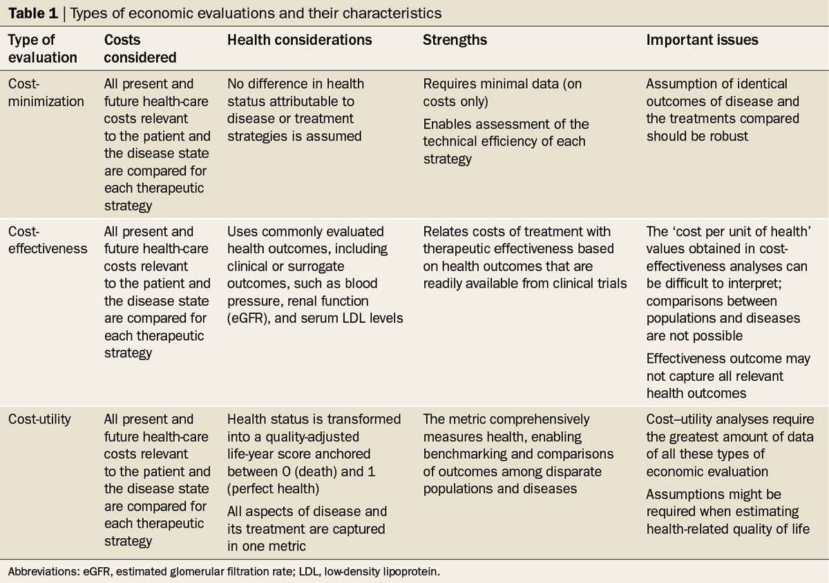
87

